Slide 1





THE GREEN GUARDIAN
An Autonomous Garbage Collector
Presented By:
Mohammad Alhalim ID: 202302489
Mohammed Farhat ID: 202301471
Mohammad Shaaban ID: 202302974
Mohammad Al Ghali ID: 202301786
Houssein Harb ID: 202301354
Zakaria Khatib ID: 202402262
Supervised By:
Dr. Ziad Doughan
FYP 1 - Fall 2025

Slide 2



AGENDA
OUTLINE
Introduction
Unit - 01
Software Design Model
Unit - 07
Project Objectives
Unit - 02
System Design
Unit - 08
Literature Review
Unit - 03
UI | Interface
Unit - 09
Proposed Solution
Unit - 04
Feasibility & Constraints
Unit - 10
Applications and Use Cases
Unit - 05
Standards
Unit - 11
System Architecture
Unit - 06
Conclusion
Unit - 12

Slide 3

INTRODUCTION
1

Slide 4


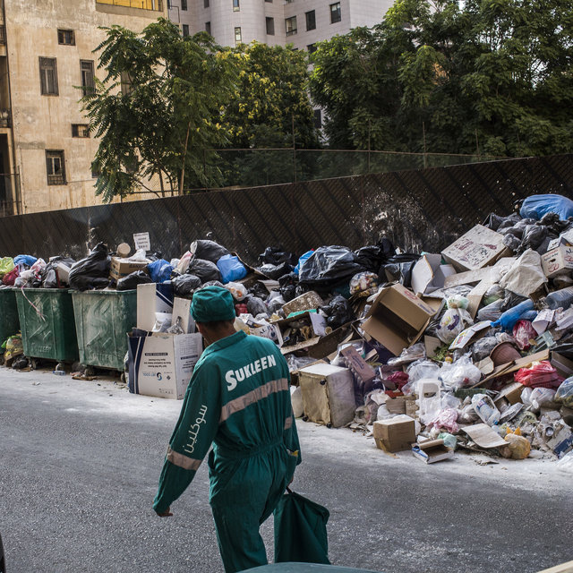

PROBLEM STATEMENT
Waste management is a major challenge in Lebanon
Irregular collection schedules in many urban areas
High dependence on manual waste collection
Increased health and safety risks for workers
Limited waste segregation reduces recycling efficiency
2

Slide 5

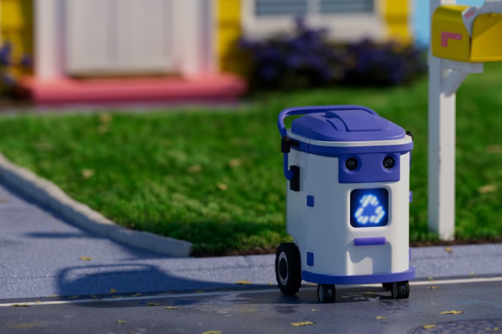

NEED FOR AN INTELLIGENT SOLUTION
Limited use of automation in waste collection systems
Inefficient waste segregation at the source
Manual processes reduce scalability and efficiency
Need for autonomous and sustainable waste management solutions
3

Slide 6

PROJECT OVERVIEW
The Green Guardian is an autonomous garbage collection robot
Designed to operate in university campus environments
Capable of detecting, collecting, and segregating waste
Operates with minimal human intervention
Focuses on efficiency, safety, and sustainability
4

Slide 7
PROJECT OBJECTIVES
5

Slide 8

PROJECT OBJECTIVES
Aim
To design and develop an autonomous garbage collection robot capable of navigating a university campus, detecting waste, and collecting it with minimal human intervention.
Secondary Objectives
Implement autonomous navigation and localization in campus environments
Detect and classify waste into organic and non-organic categories
Design a garbage collection and bin management mechanism
Integrate a sustainable power system to extend operational time
Enable remote monitoring and control through a web-based interface
6

Slide 9
LITERATURE REVIEW
7

Slide 10


LITERATURE REVIEW
System Integration & Comms | Power / Endurance | Limitations | Research Paper | Navigation & Localization | Waste Detection & Segregation
Arduino-based control | Proposed solar panel for charging | Fixed path, lacks flexibility, no waste classification | Saranya & Vigneshwaran (2020) | Line-following (IR sensors) | No segregation; only moves bin
Arduino Mega + UNO with GSM/GPS | Wireless solar charging | Low accuracy on sharp turns, cannot classify trash | Nagayo et al. (2019) | Line-following (QTR reflectance) + color sensor | Ultrasonic for trash detection
Arduino + vision processing | Battery-powered | Limited classes of waste, high compute demand | Bai et al. (2018) | Perception-driven navigation (ground segmentation + sensors) | Deep CNN for object recognition (bottles, cans, paper, etc.)
8

Slide 11
LITERATURE REVIEW
System Integration & Comms | Power / Endurance | Limitations | Research Paper | Navigation & Localization | Waste Detection & Segregation
Raspberry Pi + IoT web app | Solar-assisted operation | GPS unreliable indoors, requires good camera conditions | Harshitha et al. (2024) | GPS-based navigation (Eco-bot) | MobileNet-V2 for real-time classification (biodegradable vs non-biodegradable)
IoT (NodeMCU + ThingSpeak cloud) | Battery powered | Dependent on bin-to-robot communication | Ghosh et al. (2022) | Line-following | Smart bins report fill-level
9

Slide 12
PROPOSED SOLUTION
10

Slide 13
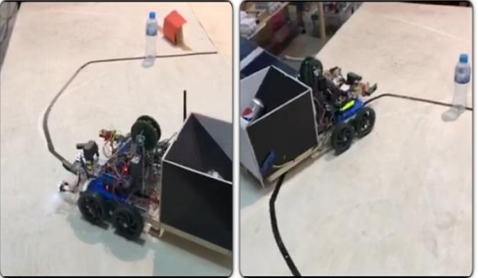
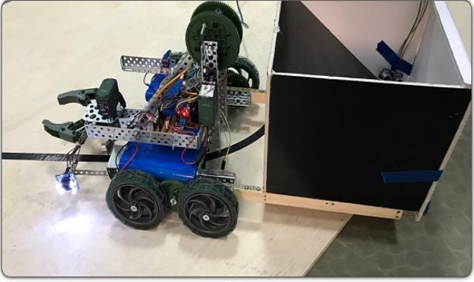
ALTERNATIVE DESIGN
Line-Following or Predefined Path Navigation
Ultrasonic-Only Obstacle Detection
Single-Bin Collection System
Battery-Only Power System
11

Slide 14
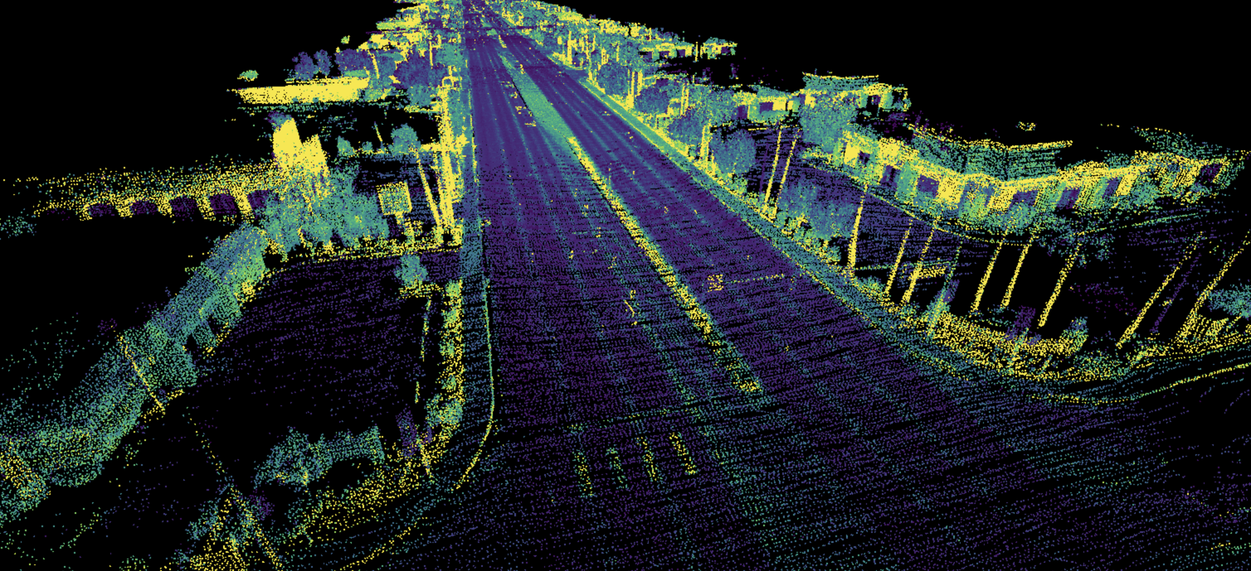
PROPOSED SOLUTION
Navigation and Localization
SLAM for map Generation
AMCL for localization
LiDAR-Based Detection for object avoidance
12

Slide 15
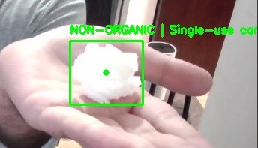
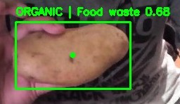
PROPOSED SOLUTION
Waste Detection and Classification
Usage of Yolo Model to identify and classify waste in real time
Classification is based on 2 criteria: Organic or Non-Organic
13

Slide 16
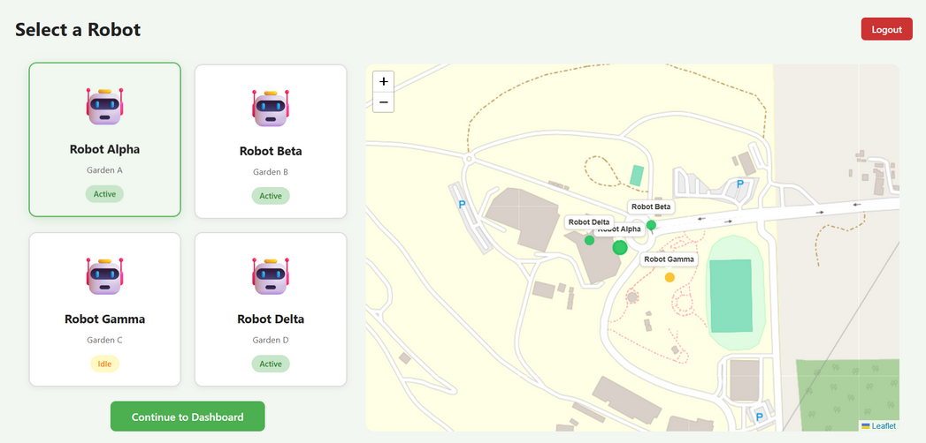
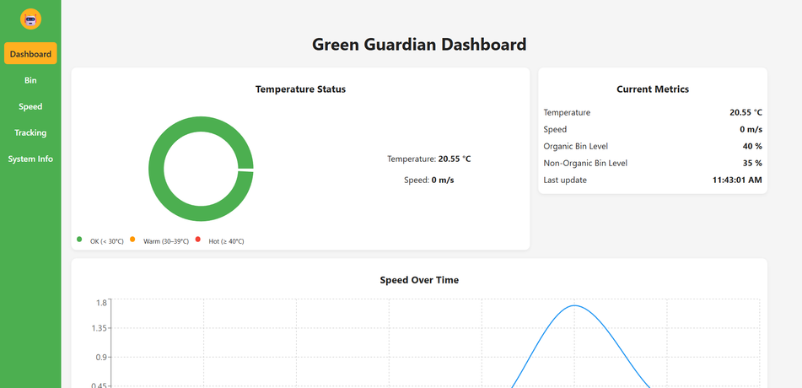
PROPOSED SOLUTION
Communication & Monitoring
Use Wi-Fi communication to send telemetry to a dashboard.
Show mission status, robot location, battery level, bin fill status, and detection events.
Allow commands like Start, Pause, Return-to-Base, and Emergency Stop.
14

Slide 17
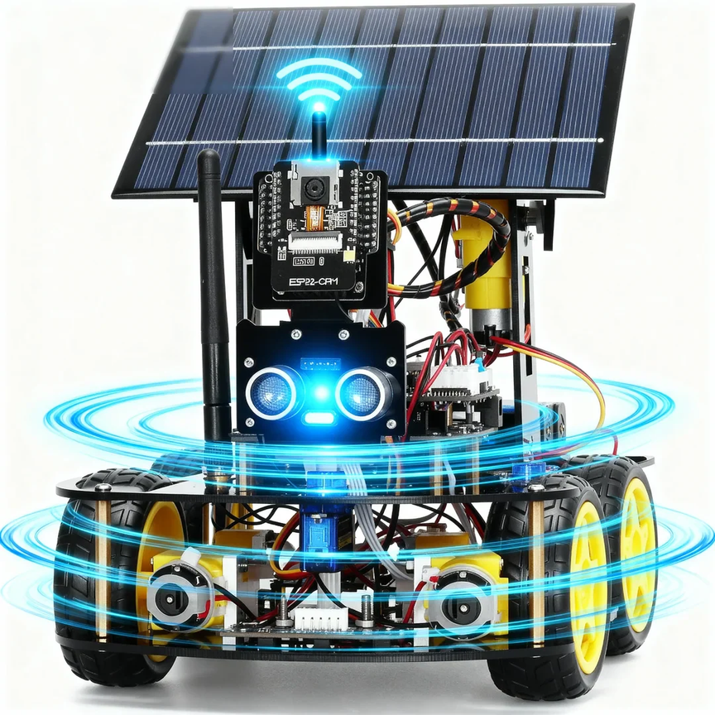
PROPOSED SOLUTION
Power & Sustainability
Use a rechargeable battery system designed for stable runtime.
Add solar assist to extend endurance and emphasize sustainability.
15

Slide 18
APPLICATIONS AND USE CASES
16

Slide 19

APPLICATIONS AND USE CASES
University & School Campuses
Smart Cities
Public Spaces
Commercial & Industrial Areas
Residential Communities
17

Slide 20
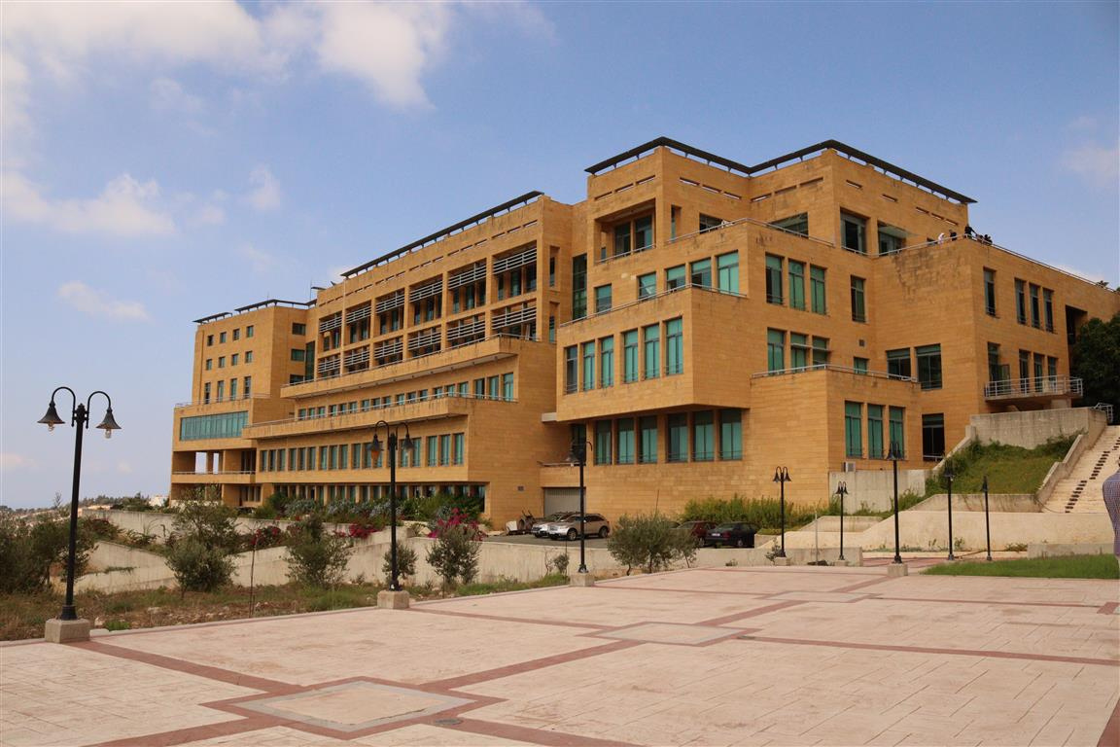
APPLICATIONS AND USE CASES
University & School Campuses
Continuous and automated waste disposal across large campuses
Reduces time and effort spent on manual waste collection
Promotes awareness of sustainability and green energy among students
18

Slide 21
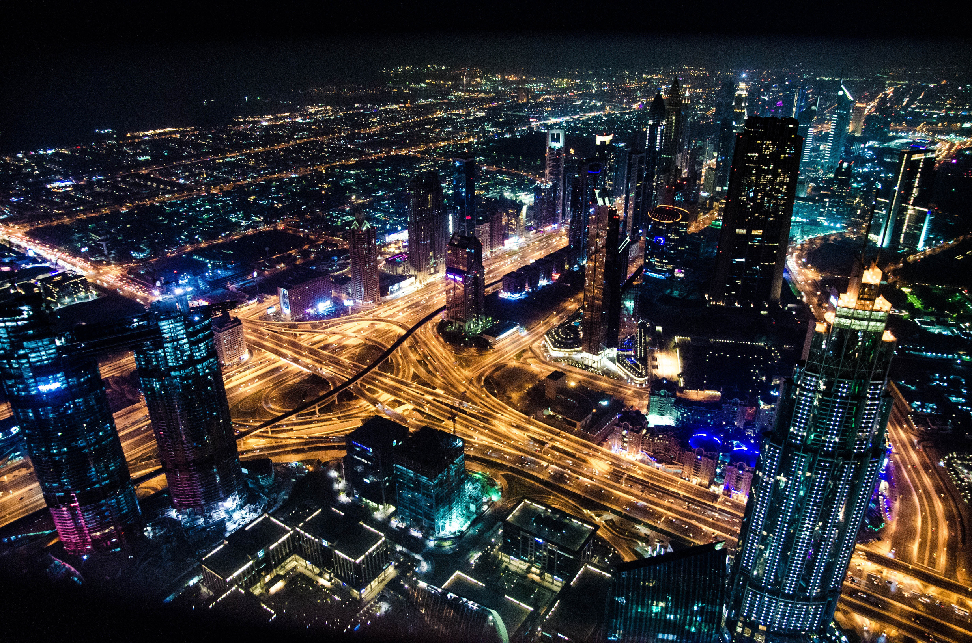
APPLICATIONS AND USE CASES
Smart Cities
Mechanized waste collection in high-density areas (streets, parks, amusement parks)
Real-time monitoring through smart city infrastructure
Optimized deployment for higher efficiency and faster response
19

Slide 22
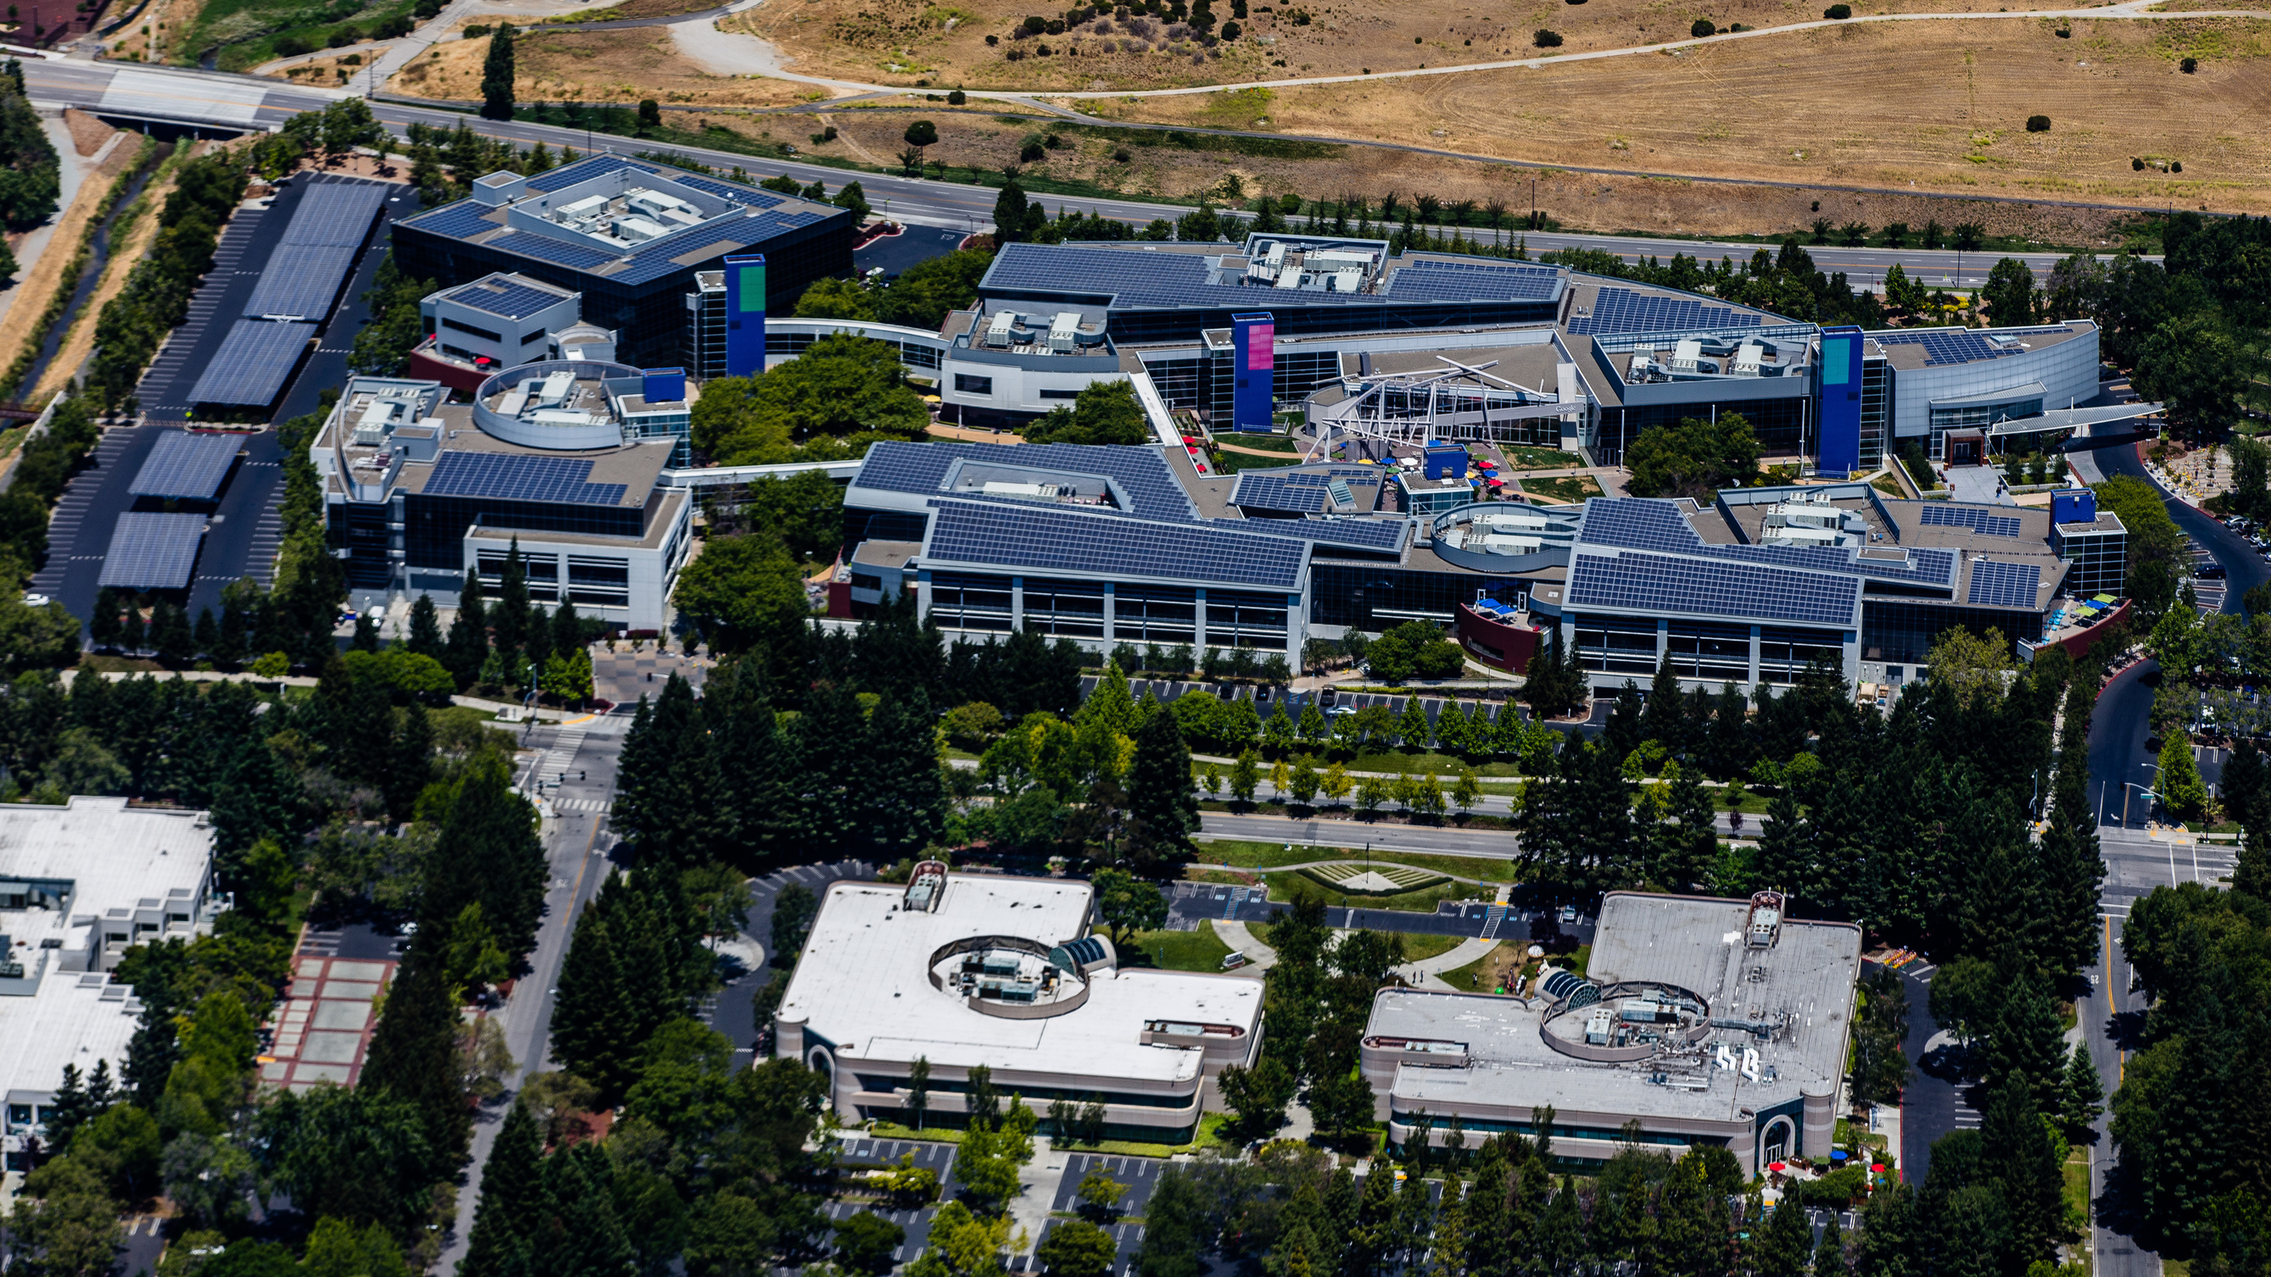
APPLICATIONS AND USE CASES
Industrial and Commercial Complexes
Efficient waste collection for high-volume waste producers
Minimizes manual labor requirements
Optimized cleaning schedules reduce operational downtime
20

Slide 23
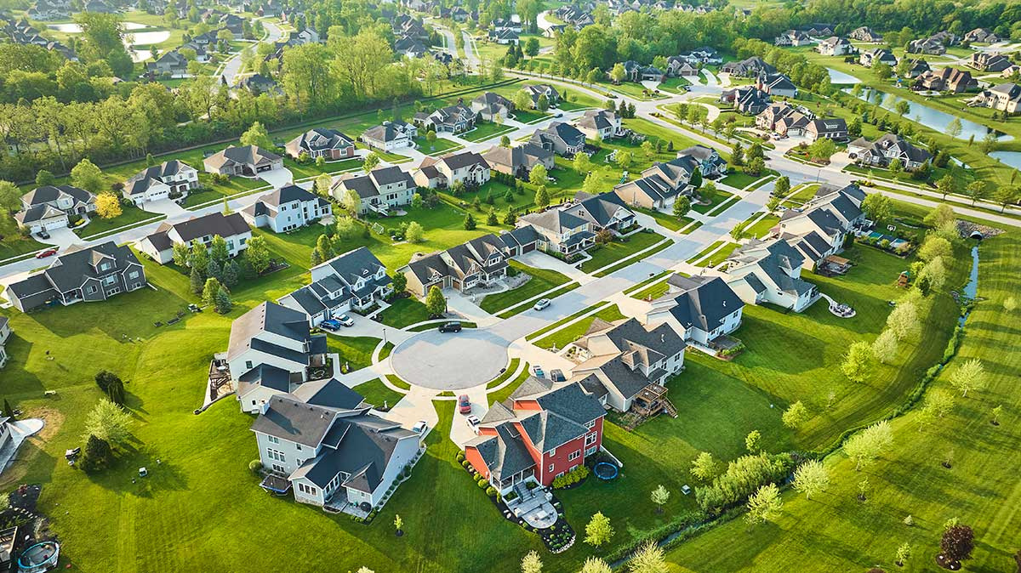
APPLICATIONS AND USE CASES
Residential Communities
Integration with IoT-enabled smart bins
Optimized route planning for waste collection
Well-organized and systematic garbage management
21

Slide 24
SYSTEM ARCHITECTURE
22

Slide 25
SYSTEM ARCHITECTURE
Hardware Architecture
Software Architecture
23

Slide 26
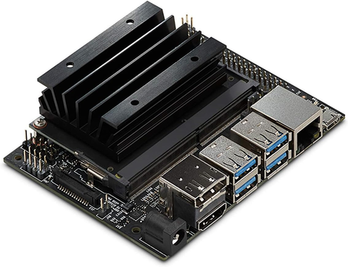





HARDWARE ARCHITECTURE
Compute Layer
Actuation Layer
Jetson (High Autonomy Tasks)
Raspberry Pi (low-level sensors and IoT)
Differential drive motors
6 DOF-arm gripper
Dual-bin mechanism
Power Layer
Sensing Layer
Rechargeable Battery
Solar charging assistant for higher endurance
LiDAR for obstacle detection and mapping
Depth Camera for depth calculation
IMU and wheel encoders for odometry and stability
24

Slide 27
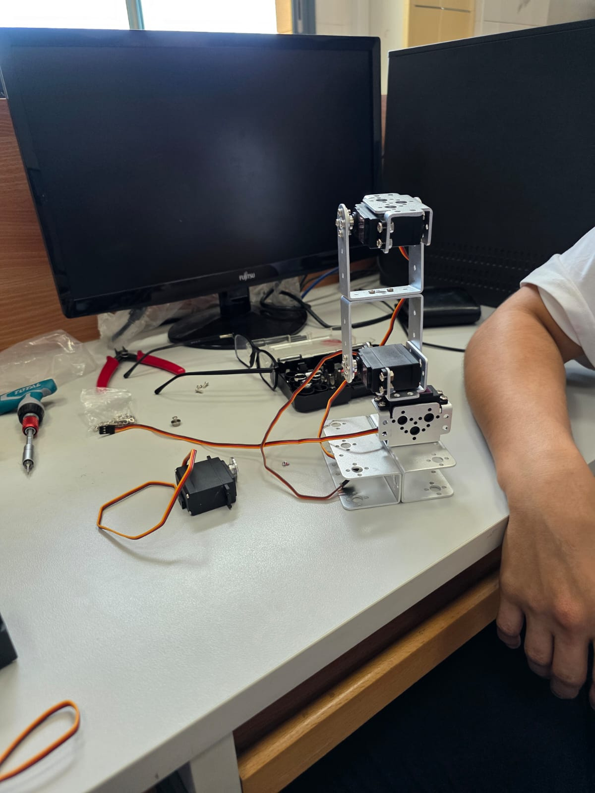
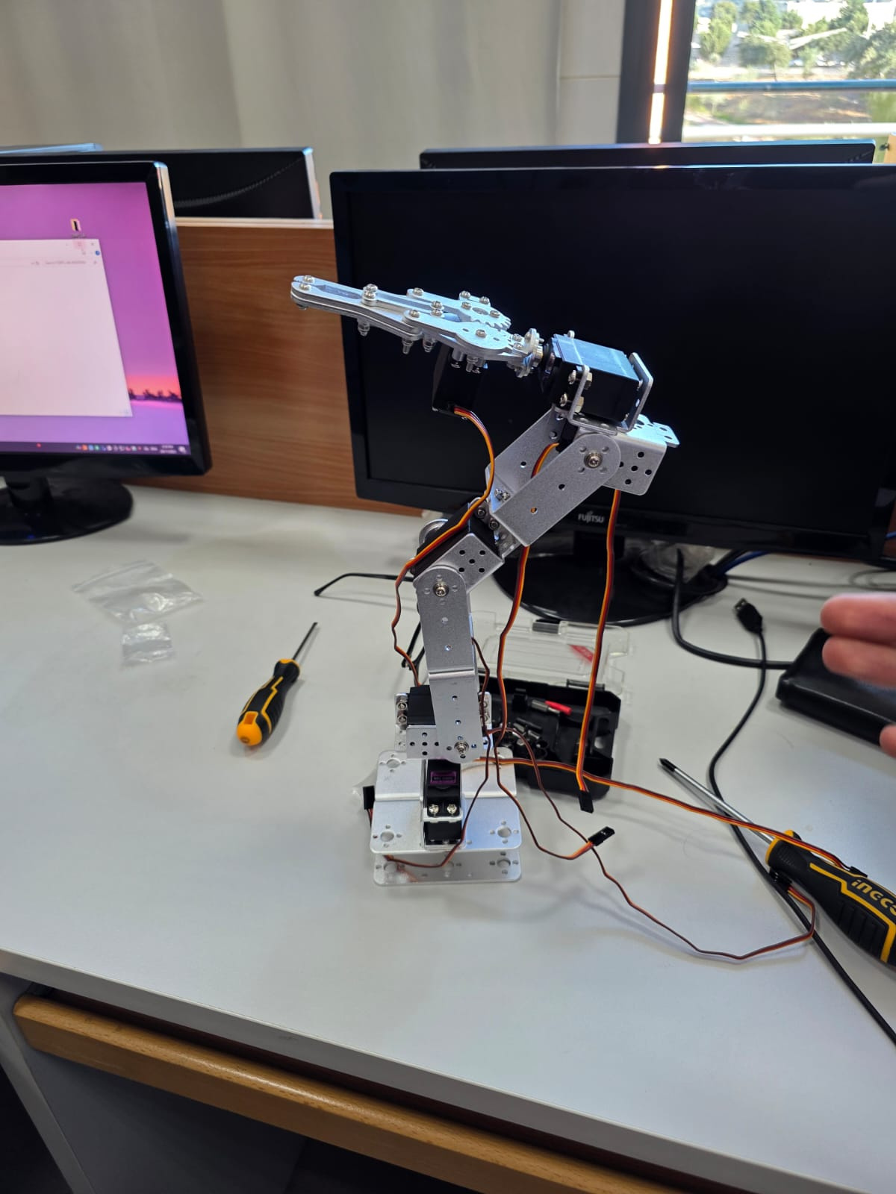
During Assembly
After Assembly
25

Slide 28






SOFTWARE ARCHITECTURE
ROS2-BASED NODES
Perception Nodes
Navigation Nodes
Mission Nodes
Communication Nodes
Waste Classification (yolov8)
Depth processing (Trash localization)
SLAM Toolbox (Map Building)
AMCL (Robot Localization)
Nav2 (global and local planner with object avoidance
Explore → Approach → Grasp → Deposit → Resume / Return to Base
ROS ↔ MQTT bridge
API backend to send topics and commands
26

Slide 29
SOFTWARE DESIGN MODEL
27

Slide 30
SELECTED MODELS
The Green Guardian software follows a hybrid development approach:
Combines Agile Incremental Model and Reuse-Oriented Model
Selected to match the nature of robotics and AI-based systems
Supports flexibility, continuous testing, and modular development
28

Slide 31
JUSTIFICATION OF THE CHOSEN MODEL
Agile Model
Development divided into small functional increments
Each increment is tested and validated independently
Allows early detection of errors and continuous improvement
Reuse-Oriented Model
Relies on existing, proven software components
Uses open-source frameworks such as ROS2 and AI libraries
Reduces development time and improves reliability
29

Slide 32
SYSTEM DESIGN
30

Slide 33
SUBSYSTEM OVERVIEW
Navigation & Localization
Perception
Collection & Bin Management
Power Management
Communication & Dashboard
Mission Manager
31

Slide 34
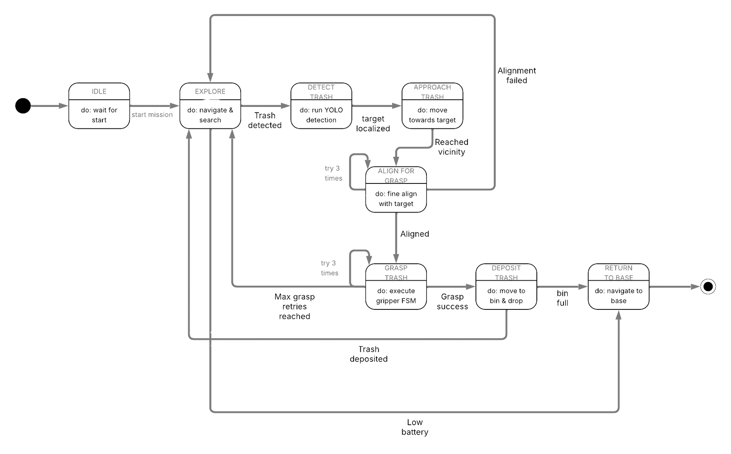
DYNAMIC MODEL DIAGRAM
32

Slide 35
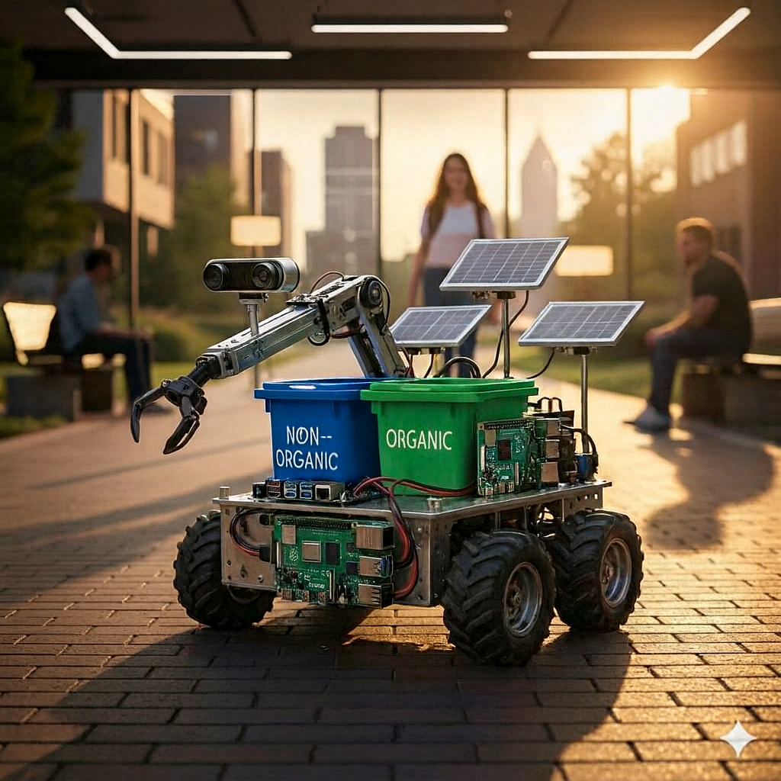
CONCEPTUAL DESIGN IMAGE
33

Slide 36
USER
INTERFACE
34

Slide 37
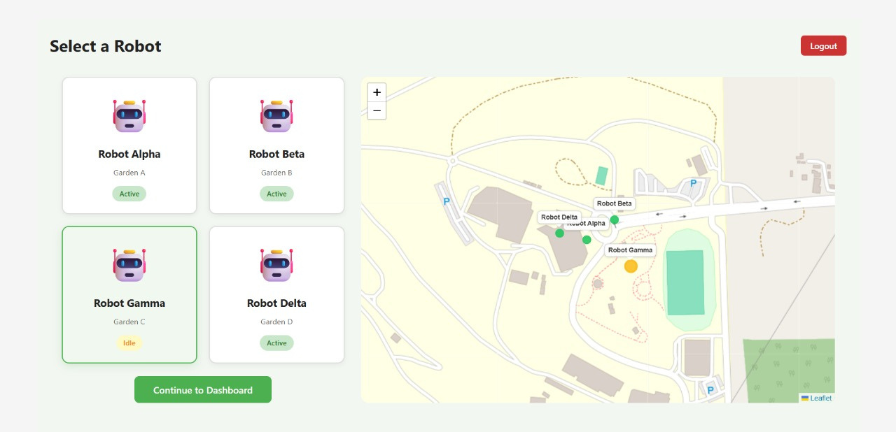
SYSTEM’S MAIN TERMINAL
Provides a centralized entry point for system access
Allows the user to select and manage available robots
Displays robot status (Active / Idle) and deployment area
Shows real-time robot positions on the campus map
35

Slide 38
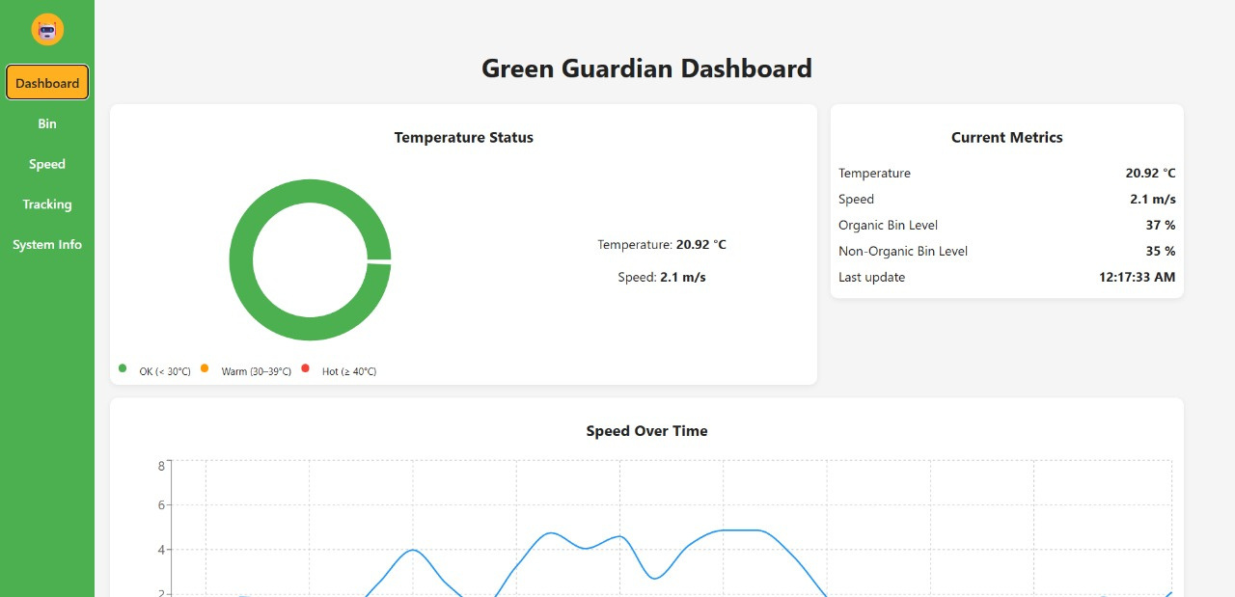
SYSTEM’S DASHBOARD
Real-time monitoring of robot status
Displays key operational metrics
Visualizes motion and performance data
Supports remote supervision and control
36

Slide 39
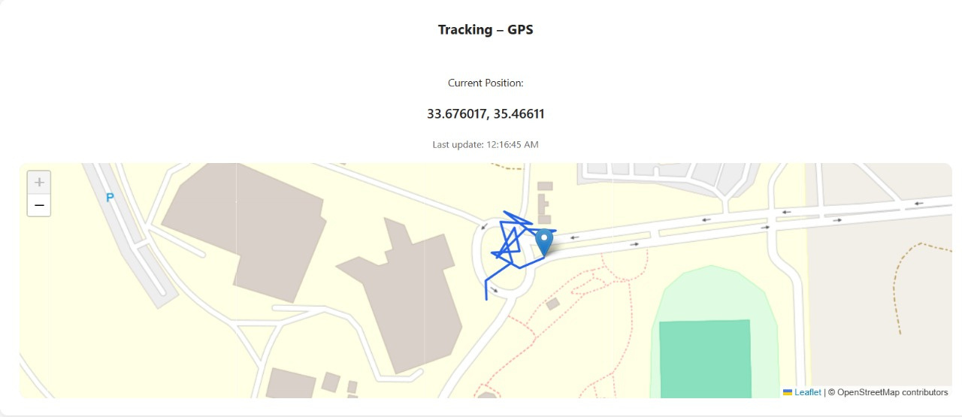
SAMPLE FEATURE
Real-time robot location visualization
Displays movement path and position updates
Supports monitoring and supervision
37

Slide 40
FEASIBILITY & CONSTRAINTS
38

Slide 41
FEASIBILITY STUDY
The feasibility of the Green Guardian project was evaluated from multiple aspects
Technical feasibility
Economic feasibility
Operational feasibility
Academic feasibility
39

Slide 42
TECHNICAL & ECONOMIC FEASIBILITY
Technical Feasibility
Use of mature and well-documented technologies
Availability of required hardware components
ROS2 provides a reliable middleware for integration
Modular design allows incremental development and testing
40

Slide 43
TECHNICAL & ECONOMIC FEASIBILITY
Component | Estimated Cost (USD$)
Jetson Orin Nano | 550
LiDAR | 550
Solar Panels (2) + Li-ion Battery | 650
Plastic Bins + Custom Chassis | 350
Raspberry Pi 5 | 350
Intel RealSense D435 | 247
Economic Feasibility
Estimated project cost is within acceptable academic limits
Use of off-the-shelf components reduces development cost
No expensive custom manufacturing required
Total Estimated Cost: ~3000-3100
41

Slide 44
PROJECT CONSTRAINTS
Technical Constraints
Limited battery capacity restricts continuous operation time
Detection accuracy depends on lighting and environmental conditions
Gripper performance varies with object shape and size
42

Slide 45
PROJECT CONSTRAINTS
Time Constraints
Project duration limited to the FYP timeline
Incremental development required to meet deadlines
Budget Constraints
Fixed academic budget limits hardware selection
Trade-offs between performance and cost
43

Slide 46
PROJECT CONSTRAINTS
Environmental Constraints
Dynamic obstacles such as pedestrians and bicycles
Outdoor conditions affecting sensors and navigation
44

Slide 47
STANDARDS
45

Slide 48
STANDARDS
Safety & Reliability
IEC 61508 – Functional safety and system reliability
System Architecture & Terminology
ISO 8373 – Robotics terminology and definitions
IEEE 1872 (ORA) – Ontologies for robotics and automation
Sensors & Communication
IEEE 1451-1 / 21451.0 – Smart sensor interfaces and plug-and-play data formats
IEEE 802.11 – Wireless communication (Wi-Fi)
Navigation & Mobility
ISO 18646-1 – Performance criteria for wheeled mobile robots
Power & Environmental Compliance
IEC 62133-2 – Lithium-ion battery safety
ISO 14001 – Environmental management and sustainability
AI & Ethical Operation
IEEE 7007 – Ethical robotics and autonomous systems
ISO/IEC 22989 – AI concepts and terminology
46

Slide 49
CONCLUSION
47

Slide 50
CONCLUSION
The Green Guardian successfully demonstrates an autonomous waste collection system that integrates robotics, artificial intelligence, and sustainable energy solutions.
Key Contributions and Impact:
Reduces human exposure to hazardous and repetitive waste collection tasks
Improves waste segregation efficiency through AI-based classification
Enhances cleanliness in campuses and public spaces via autonomous operation
Demonstrates the feasibility of solar-assisted robotic systems
Provides a scalable foundation for smart city and environmental robotics applications
48

Slide 51
THANK YOU
49

